Slide 1
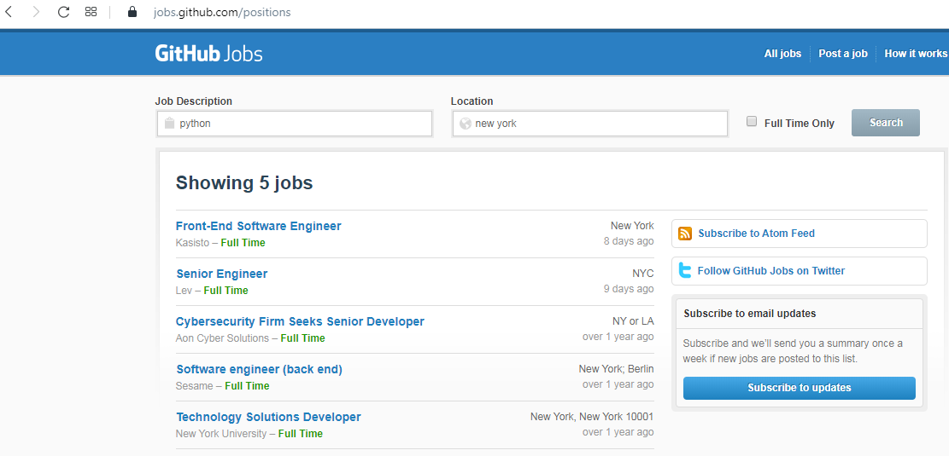



How to use an API?
Client
Request
Response

Slide 2
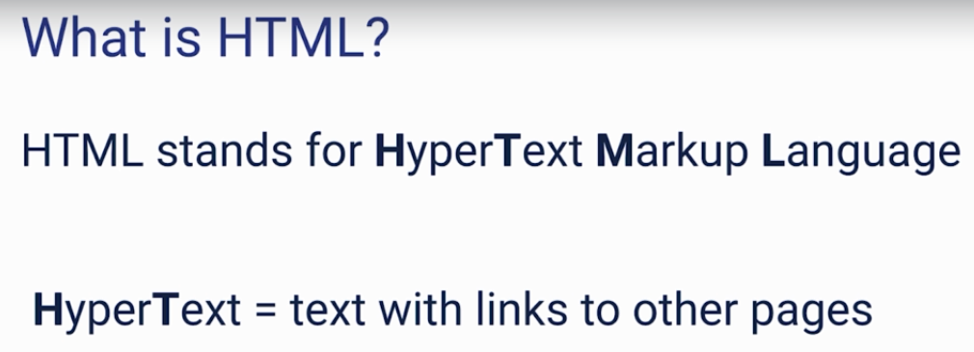
How to use an API?

Slide 3
How to use an API?
https://jobs.github.com/positions?description=python&location=new+york
https://jobs.github.com/positions.json?description=python&location=new+york

Slide 4
Before Spring Boot
https://www.udemy.com/course/introduction-to-apis-rest-api-graphql-soap-web-services-grpc/learn/lecture/19537442#overview
https://jobs.github.com/positions?utf8=✓&description=java&location=new+york

